Slide 1
Co-learning with
(and as) experts
A permeating theme
Notes:
Mentor note: Ask trainee(s) to reflect on what we mean by expertise. It will be important for trainees to have read and reflected on the training materials linked to adaptive expertise.
Reflect on the notion of expertise. What do we need expertise in as a teacher of all pupils? It will be useful to refer trainees to the training slides on noticing, inclusive pedagogy and the graduated approach and ask them to consider how their learning from these permeating themes has framed their understanding of the expertise of a teacher.

Slide 2
A professional role
…starting with you – the teacher!
Take a moment to picture a teacher – this might be a teacher from your own schooling, a colleague, a teacher from a film or a book…
Thinking about them as a teacher, how would you describe their role in the classroom? In the school? In the wider community?
Consider their role as experts? What would you describe them as being experts in?
Does this resonate with you? Is this how you would view yourself as a teacher?
How would you describe your role? What do you see as your expertise?
Notes:
Mentor notes: Use this as an opportunity to asses/explore the trainee’s understanding of the role of the teacher. Where in their journey are they? Do they see themselves as classroom managers? Curriculum deliverers? Facilitators? Educators? Weavers of knowledge and skills? Etc.
How do they understand the interdependency of their role to their relationships with their students, with others, with the context in which they are working? Explore this with them both in relationship to their role in the classroom and their wider role as part of the school community.

Slide 3
A professional role
Hi!
Hi!
Our in-role expertise is not fixed, but develops as we learn and reflect.
Our ideas and practice are expanded and influenced by those around us and their expertise.
Our role is ‘performed’ in relation to other people.
Notes:
Mentor notes:
Reflect with trainee(s) on the pitfalls of viewing our roles as static and something that we carry out in isolation. Reflect with trainee(s) the benefits of and opportunities presented by our role being performed in relation to other people and the strength of working in teams in school. Acknowledge, alongside the opportunities, the complexities presented by the fact that our roles are carried out within the dynamics of relationship and interrelationship.
The next slide asks the trainee(s) to consider who the ‘other people’ referred to in the slide are when considering our role in school. When discussing who these ‘people’ are, consider therefore how our relationships with them might be impacted by and might impact the way we carry out our roles.

Slide 4
Who is on your team?
A teacher’s role is never in isolation.
Our task at hand can be challenging at times. However, there is a wider community to support and encourage us as we learn and develop in the role.
Make a list.
In relation to how you carry out your role as a teacher, who do you speak with…
Daily?
Weekly?
Fortnightly?
Termly?
Notes:
Mentor notes:
Reflecting on the previous slide, consider how our relationships with the people in our team might be impacted by (and might impact on) the way we carry out our roles.

Slide 5
The team within the school
Our teaching community starts within our own school through the professional relationships we develop with colleagues in our year group/phase and the support staff working within our classrooms.
Your team includes:
Middle and senior leaders, e.g. curriculum leads, phase leaders, SENCO, designated safeguarding lead, EAL lead, Pupil Premium lead
External agencies, e.g. specialist teachers, speech and language therapists, occupational therapists, educational psychologists, CAMHS
Wider professional networks, e.g. fellow trainee teachers, Whole School SEND, Maths Hub Programme, English Hubs programme, Chartered College, Teacher Union

Slide 6
Who is on your team?
And most importantly:
The learners in your class
The families of the learners
Reflect on this slide.
Had you considered your learners and their families as a part of your team?
Why, or why not?

Slide 7
So who has an investment in a child or young person’s learning and development?
Notes:
Mentor notes:
Think about the networks and the systems that we work within in school with the trainee e.g. School, Phase, Department, in relationship with other colleagues, with the learners, with the learners’ families, external agencies, specialist teachers, health etc.
Ask the trainee(s) to consider where they see themselves within this network. Do they feel that their position in the system changes depending on context or who they are ‘in relationship’ with? Why?
It will be important to elicit from trainee(s) the central role that they play in this network since in school as the child or young person’s teacher, they will have an in-depth knowledge of their learners. It important for trainee(s) to understand that:
They will notice when the learner does well and when they struggle
They will have a good idea of what challenges they face in order to achieve as well as they can
They will know when their teaching is most successful
They have the opportunity to relate to the learner and ensure that the learner has agency (alongside their family) with regard to the development of any additional support
They have the opportunity to build relationships so that their learners respond and engage with any additional support and broader learning opportunities
etc.

Slide 8
How are we perceived by others, when we are in role and how do we perceive ourselves? How do we communicate our perceptions of others and how are these perceptions received?
How are we perceived by others, when we are in role and how do we perceive ourselves? How do we communicate our perceptions of others and how are these perceptions received?
For good team work to take place, it is important to recognise our preconceptions about each other and each other’s roles and to learn and respect the diverse contributions that each person plays in understanding a learner’s needs and therefore also in implementing effective provision to meet those needs.
We are people-in-role, and we are also people-in-role-in-relationship with others.
Notes:
Mentor notes:
We talk about the professional role of the teacher in relation to:
The people involved (who we are and who ‘they’ are)
What we believe our role to be (our identity)
How we feel our role as a teacher is defined by others (our identity)
What we do (our job description)
How we do it (school policies)
What we are expected to do (our context) – both explicitly/formally and implicitly/informally
How we respond to people, tasks and organisational contexts both personally and professionally (our characteristics and emotions)
Understanding our role as well as our role-in-relationship with others positions highlights two key aspects of the role of teacher:
The teacher as a learner
The teacher as part of a wider collaborative team

Slide 9
How can our practice be enriched by these relationships within the system?
Notes:
Mentor notes:
Ask trainee(s) to also consider whether there are barriers/hindrances that occur as a result of these relationships. What are these? Are there feelings associated with these? Take time to explore feelings that can be evoked when fulfilling our roles in relationship – fear of failure, anxiety around asking for help, power dynamic etc. Acknowledge some of these feelings whilst also reflecting on how these feelings/perceptions could be flipped so as to enrich how we carry out our role.
Ask trainee(s) to consider what the opportunities and benefits are of working as part of a wider team within the system. What are these? Are there feelings associated with these? Take time to explore the positive feelings that can be evoked when fulfilling our roles in relationship – understanding, collaboration, feelings of success etc. Reflect on how these can be harnessed to have a positive impact on the learning experience of and provision for leaners.
Support the trainee(s) to consider this in relation to the following areas:
The notions of expertise
The power dynamic of the institution
The role of pupil voice
The role of parents/carers
Take time to focus the discussion on what is in our gift as teachers – acknowledge that there will be points raised that our not in our control and focus in on those points that we can control or that we can influence to promote effective teamwork to best support our learners.
Threaded into these discussions, it will be important to bring the conversation back to our core purpose as educators. It will be important for trainee(s) to understand that navigating our relationships in role is central to our role as teachers and the impact that we have in our roles. By understanding our perceptions when in role and navigating the many relationships, we develop a supportive, collaborative approach in the best interests of our learners.

Slide 10
A Dynamic Process of Co-Learning
Collaborative Partnerships
Working with Families:
The weft and the warp creating a strong fabric in a dynamic partnership
Notes:
Mentor notes:
When working in partnership, it can be helpful to consider how we relate to each other within the partnership/team in role rather than our relationships within the partnership/team. If we focus in on our relationship, we judge the quality of relations in terms of liking/not liking, getting on/not getting on, commonalities.
A collaborative partnership does not need to be predicated on commonalities or liking/not liking. A collaborative partnership exists because we are persons-in-role with a common shared purpose and we are related through this. We need to be committed not to ‘getting to know each other’ and building a relationship but to respecting each other’s contributions. This allows us to engage in a dynamic process of co-learning so that we can understand learners’ experiences, including any barriers, and therefore how we can best implement and adapt our pedagogy and provision to meet those needs. We do not need to know each other – we are related as co-members of the team. We respect that we have different roles and it is in understanding how these different roles weave together that we create effective provision.
In this partnership, it is important to understand that we are all learners, co-constructing together as we learn and evolve. This is a dynamic process. It is also essential that we understand our role, as teachers, in building these collaborative partnerships – the time invested at the beginning of our journey alongside a learner in establishing these lays important foundations for future successful partnerships.

Slide 11
A child’s family is their first teacher.
Teacher
Children
Families
Teachers should view families as partners, collaborators and advocates for their child(ren).
Parent participation enables a communication network that leads to fuller and more reciprocal knowledge, as well as to a more effective, shared search for the best educational methods, content, and values.
Loris Malaguzzi, Reggio Emilia (1993)
Notes:
Mentor notes:
Use the quote from Loris Malaguzzi to reflect on the role of families in the graduated approach on the next slide.
Refer trainee(s) back to the training slides on the implementation of the graduated approach.
In order to achieve effective partnership when working with families, it is essential that families are respected and recognized as experts on their own children. (Athey, C [1990] Extending thought in young children: A parent-teacher partnership, London: Paul Chapman)

Slide 12
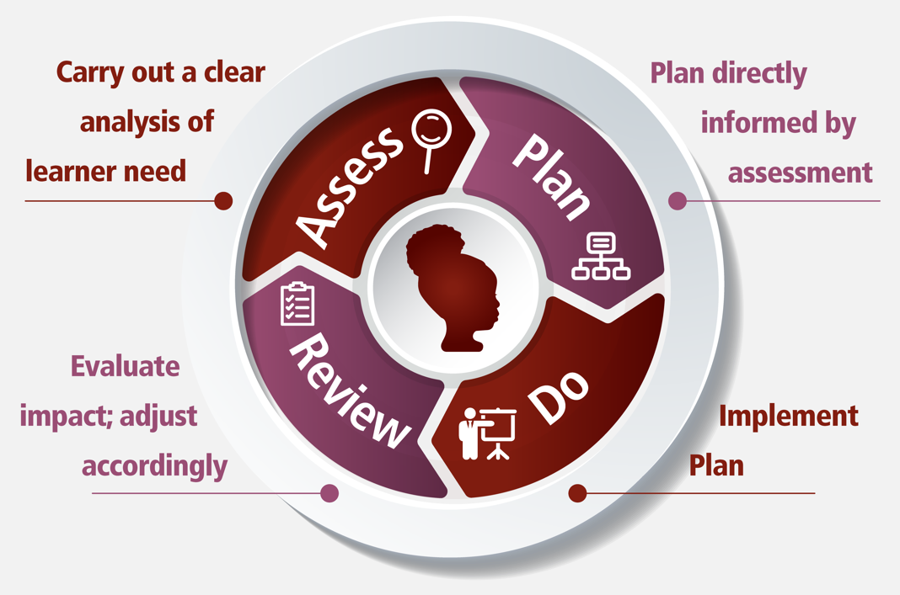
Graduated Approach
Teacher
Children
Families
Notes:
Mentor notes:
Key reflective questions to explore with the trainee(s):
What is the role of families in carrying out a clear analysis of the learner need? How would families be involved at the other stages of the Assess-Plan-Do-Review cycle? What is the role of families in evaluating the impact of any intervention/provision? How would their view impact adjustments that might need to be made further?
The graduated approach allows us to ‘test and learn’ as professionals as part of the team as we identify which adaptations and provision are needed to ensure appropriate access to a broad, balanced and ambitious curriculum. This is a dynamic cycle around the learner(s) – this is informed by the dynamic process of co-learning that takes place through our partnership working with other members of the team but especially families.

Slide 13
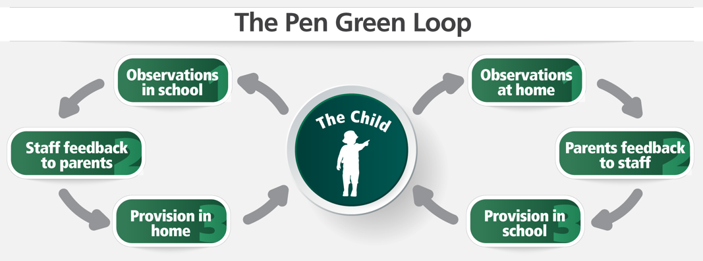
Notes:
Mentor notes:
The Pen Green Loop highlights the process of information-sharing between home and school.
How does this support the graduated approach?

Slide 14
Case Study: Family Perspective
Every parent I know who has a child with SEND feels the need to be their advocate when it comes to school. As a parent of three children with SEND and a school governor with responsibility for SEND, I see both sides. I see the enormous and ongoing commitment and hard work put in by staff. I see how children most in need are rightly prioritised. And I see how schools can’t do everything – but can sometimes do more when parents are vocal. Even better would be a proactive approach from schools, encouraging feedback about their provision and having honest conversations about what is possible. The better the communication and collaboration, the better the relationships and outcomes for the children.
Sometimes I’ve only found out about changing provision for my child when I’ve sought feedback. For example, that my son was now on a blue fidget cushion or that my daughter was being allowed to doodle during carpet time to help her maintain focus. These may feel like small adjustments to teachers but to parents these are essential nuggets of information in understanding our children and their developing needs. To not share information is potentially damaging to the sense of partnership and trust we need between us. We want to support our children as best we can!
My son is now in Year 8 and I think that for every school report he’s had there have always been comments along the lines of ‘He needs to focus more’ or ‘He’d do even better if he paid more attention,’ or, now that he’s in secondary school, that he’s not sufficiently organised. I know these comments are meant to be helpful but to a child with ADHD (and their families), they can be demoralising, as if the teacher doesn’t understand the inherent challenges or their own role in supporting them. More constructive would be acknowledging the challenges by including information on how the teacher is working alongside my child to support their focus or their organisational skills.
Notes:
Mentor notes:
Give time to the trainee(s) to read this case study and reflect on what this means for:
their practice
how they carry out their professional role
how they carry out their professional role-in-relationship

Slide 15
Reflect on your practice:
Think about a recent conversation you had/observed with a family that went well.
What information were you sharing?
What do you think made the conversation go well?
Notes:
Mentor notes:
It will be important for the trainee(s) to reflect on any foundation work that had taken place prior to the conversation that supported its success. Remind trainee(s) about the reflections captured through the exploration on slide 10 regarding the difference between relationships and relating in role. How did the conversation reflect the notion of relating in role where the contributions of all are afforded equal weighting? How was this communicated both verbally and non-verbally? How was the conversation contextualised to support the success of the conversation?

Slide 16
Reflect on your practice:
Now have a think about a recent conversation you had/observed with a family that did not go as planned.
What information were you sharing?
What do you think made the conversation more challenging than initially expected?
Think about the verbal and body language you observed?
Notes:
Mentor notes:
Remind trainee(s) about the reflections captured through the exploration on slide 10 regarding the difference between relationships and relating in role. How did the conversation reflect the notion of relating in role where the contributions of all are afforded equal weighting? How was this communicated (or not) both verbally and non-verbally? What were the barriers that impacted the success of the conversation?
If trainees are reflecting on a conversation they had, what would they do differently if they were to have the conversation again?

Slide 17
Key considerations for effective partnership working with families
Be aware of your own unconscious bias and adjust your interactions if necessary. Avoid judgment and assumptions.
Make contact before you ‘have to’, to ensure that you establish a positive relationship with the family. Do not wait until you have ‘concerns’ to share.
Listen to and engage with the contributions of families. Be mindful that some children and young people present very differently at home to school.
Be open, honest and transparent with families – parents and carers have a right to know. Be sensitive when sharing concerns and seek advice from the SENCO as appropriate. Respect professional boundaries – for example, we are not health professionals and do not have the expertise to diagnose!
Be mindful of the imbalance between the institution of school and the family. You represent the institution, and to the family it can feel as if you hold the power, even if you do not feel that you do!
Be mindful of any specialist language or jargon – establish a shared understanding of the language with the family.
Always act and communicate in the best interests of the child or young person.
Notes:
Mentor notes:
Parents can also perform a role for school staff, particularly if they feel uncomfortable, anxious or powerless. How can teachers and school staff initiate a conversation that demonstrates to the parent/carer that power is shared, or that helps them to feel more at ease?

Slide 18
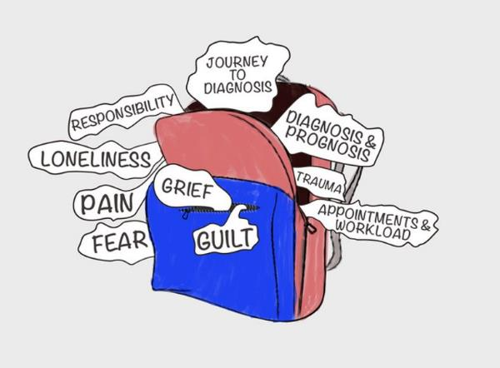
Key considerations for effective partnership working with families
The emotional rucksack represents some of the emotions, experiences and memories that can be carried by families of children and young people with complex needs, accumulated along the journey. This can impact on every interaction with professionals. Past experiences can transfer into the present moment. As teachers it is in our power to come from a position of empathy and understanding.
When teachers understand the ‘emotional rucksack’ that families are likely to be carrying alongside the profound love for their child, then a more effective partnership can be achieved – a partnership that benefits all.
Notes:
Mentor notes:
Below are some additional details about the emotions –
Grief of seeing your child not having the life you might have expected them to have, or the life you think other people are leading.
Experience of the journey to diagnosis – not always being believed or heard by professionals.
Trauma of appointments and the responsibility of making medical decisions.
Feeling overburdened by the workload involved in the management of the administration linked to all the appointments and other aspects of support.
Fear of the future – will their child be able to manage independently?
Families may experience loneliness when their child’s developmental path is acutely different from that of their peers. A separation from other families may occur.

Slide 19
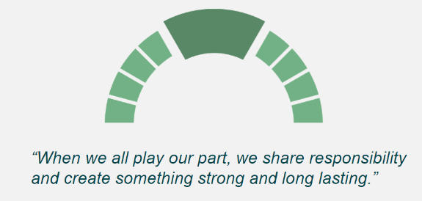
Collaborative Partnerships: A Dynamic Process of Co-Learning
Working with Other Professionals: distributed responsibilities and valuing each other’s contributions and expertise
Notes:
Mentor notes:
Use this slide as a reminder of slide 5 (‘who is on your team?’):
Middle and senior leaders, e.g. curriculum leads, phase leaders, SENCO, designated safeguarding lead, EAL lead, Pupil Premium lead
External agencies, e.g. specialist teachers, speech and language therapists, occupational therapists, educational psychologists, CAMHS
Wider professional networks, e.g. fellow trainee teachers, Whole School SEND, Maths Hub Programme, English Hubs programme
Explain that we will be looking in particular at the role of the SENCO and the role of external agencies in the coming slides.
Use this slide as an opportunity to remind trainee(s) of key reflections from slide 10 and how the notion of a dynamic process of co-learning translates to working with other professionals. Please see notes from slide 10 below as a reminder:
When working in partnership, it can be helpful to consider how we relate to each other within the partnership/team in role rather than our relationships within the partnership/team. If we focus in on our relationship, we judge the quality of relations in terms of liking/not liking, getting on/not getting on, commonalities.
A collaborative partnership does not need to be predicated on commonalities or liking/not liking. A collaborative partnership exists because we are persons-in-role with a common shared purpose and we are related through this. We need to be committed not to ‘getting to know each other’ and building a relationships but to respecting each other’s contributions. This allows us to engage in a dynamic process of co-learning so that we can understand learners’ experiences, including any barriers, and therefore how we can best implement and adapt our pedagogy and provision to meet those needs. We do not need to know each other – we are related as co-members of the team. We respect that we have different roles and it is in understanding how these different roles weave together that we create effective provision.
In this partnership, it is important to understand that we are all learners, co-constructing together as we learn and evolve. This is a dynamic process. It is also essential that we understand our role, as teachers, in building these collaborative partnerships – the time invested at the beginning of our journey alongside a learner in establishing these lays important foundations for future successful partnerships.

Slide 20
The role of the SENCO in relation to the role of the teacher
The SENCO has an important role to play with the headteacher and governing body, in determining the strategic development of SEN policy and provision in the school.
The SENCO has day-to-day responsibility for the operation of SEN policy and coordination of provision made to support pupils with SEN, including those who have EHC plans.
The SENCO provides professional guidance to colleagues and will work closely with staff, parents and other agencies.
Teachers are responsible and accountable for the progress and development of the pupils in their class(es), including where pupils access support from teaching assistants or specialist staff.

Slide 21
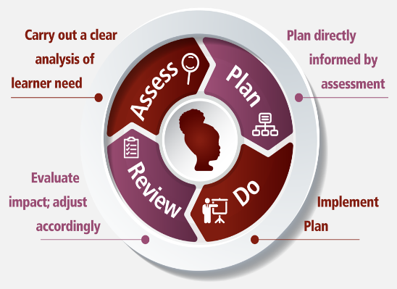
A graduated approach
Notes:
Mentor notes:
Refer trainee(s) back to training slides on the implementation of the graduated approach.
The SEND Code of Practice makes explicit that every teacher is a teacher of SEND and that we are responsible for the learning of all pupils in our classes. We will not achieve this in isolation; it is is co-learning and working in partnership with others that we will be able to fulfil our duties as teachers of all pupils.
It will be important for trainees to consider that a collective, shared responsibility is predicated on a distributed model where everyone has a role to play in supporting pupils with SEND and that it is in everyone carrying out their role that we are able to build a sustainable and effective approach. Understanding what is our role as teachers is essential; similarly understanding how and when to seek support from other colleagues and/or the SENCO and when to work in partnership with external agencies is essential. It is also important to remember that when working in partnership using a distributed approach, we will be carrying out our roles in parallel.
Explain that on the next slide we will consider the graduated approach as we tighten our provision around a child. This will be an opportunity to reflect on the role of the teacher in relation to the role of the SENCO as we move dynamically through the graduated approach. It will be important to note that this is not a linear process where we move inevitably towards specialist support but this is a dynamic process where e.g. the SENCO might need to work in partnership with the teacher intensively for a while but then might be able to step away; or the SENCO might give some informal advice to the teacher which might suffice in supporting a significant enough adjustment.

Slide 22
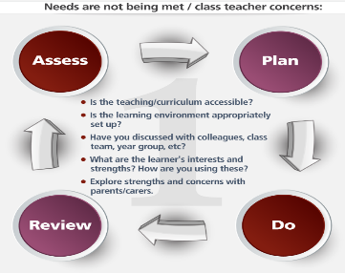
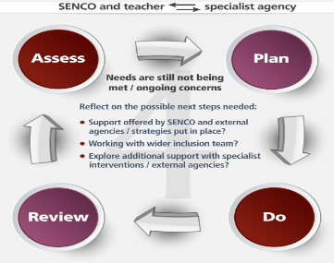
A graduated approach
Notes:
Mentor notes:
Reflect on the role of the teacher in relation to the role of the SENCO.
Learning is not linear, and individual learners may require additional support at different times in their school life. A recent analysis from the Education Policy Institute highlighted that 39% of learners are identified as having SEND at some point during their time at school.
It is important to remember that when assessing learners, progress can be linear, lateral as well as spikey. As the teacher, you bring expertise on the individual learner through the graduated approach. Your observations and formative assessments of a learner, including their engagement in learning activities, interactions with peers and progress within the curriculum, are fundamental to the development of a holistic understanding of a learner.

Slide 23
Case Study: Collaborative partnerships to support effective provision
Josef is 14 years old and has a diagnosis of autism. He has Speech, Language & Communication needs (SLCN) and uses British Sign Language (BSL) signs to support his limited speech. He can get frustrated with his SLCN in particular when his peers and the staff are unable to understand him or respond to his needs. This in turn has made it challenging for Josef to form positive relationships with others. He likes his own company and can appear to be quite isolated.
Josef shows great talent across a number of sports and has the potential to compete at an elite level. Winning the school cross country was a highlight for him and made his family and teachers very proud. His great passion is rugby and he has aspirations of playing professionally and maybe even one day representing his country.
Academically Josef’s performance is behind many of his peers and he attends intervention / booster sessions in core subject areas (English & maths). He is happy to be in a mainstream school as he was very aware of being different to his peers in his last school, which was a special school.
Notes:
Mentor notes:
Use this case study in conjunction with slide 22 to reflect on the role of the teacher and the role of the SENCO in securing the right provision for Josef as well as supporting his inclusion in the mainstream setting.
Key questions for reflection -
How might this look different over the course of the day or a week? How might this look different in different subject areas?
Which additional expertise from other colleagues would you draw upon? Why?
Remembering that ‘every teacher is a teacher of SEND’, what is our responsibility? How would working in partnership with the SENCO and other colleagues support us in meeting our responsibilities as Josef’s teacher?
Refer trainee(s) to reflections made when engaging with the case scenarios/signpost trainee(s) to the case scenarios - how they would co-learn in collaborative partnerships within these scenarios.
Suggested extension activity: Choose two scenarios and compare the role of the teacher and the SENCO in the two chosen scenarios. What are the commonalities? What are the differences? And why?

Slide 24
Case Study: Collaborative partnerships to support effective provision
When Josef is motivated and has good relationships with his teachers his eyes sparkle and he comes to life showing fantastic potential and a desire to learn.
Josef has an EHC plan to support his moderate learning difficulties and SLCN.
Josef’s pastoral teacher has built a positive relationship with him and her strong, universal strategies (structure, visual support, use of basic BSL signs) make the classroom accessible and inclusive for all. Josef’s challenges generally come when working with subject teachers away from his pastoral base, in particular in lessons such as PE, music & drama where there can be less structure.
Josef’s peers are welcoming although they have not experienced learning alongside a child with Josef’s level of need before. Some students have said they get scared when he is finding it difficult to regulate.

Slide 25
The role of the teacher in relation to external agencies and specialist teachers
Speech and Language Therapist
Occupational Therapist
Physiotherapist
Mental Health Worker
Educational Psychologist
Qualified Teacher of the Deaf
Qualified Teacher of Children and Young People with Vision Impairment
Dyslexia Specialist Teacher
Notes:
Mentor notes:
Explain that we will now focus on working with external agencies and specialist teachers. It is important to remember that as the teacher, you bring expertise on the individual learner through the graduated approach. Your observations and formative assessments of a learner, including their engagement in learning activities, interactions with peers and progress within the curriculum, are fundamental to the development of a holistic understanding of a learner.
In some instances, a SENCO may refer a child to an external agency or specialist teacher for assessment. This referral is completed in partnership with the learner and their family. Once submitted, a multi-disciplinary team will consider the information provided in the referral and determine if further investigation is needed.
A referral to an external agency or specialist teacher may result in:
-Feedback to the school on further strategies to try in the classroom prior to re-submitting a referral if needed at a later date
-Further investigation, which will typically include:
--an observation of the learner in the school and/or at home
--conversations with the learner, their family, and school-based staff working with the learner
--Standardised assessments, e.g. clinical assessments, questionnaires, rating scales
If further investigation is agreed, a comprehensive report will be shared with the family, and with the family’s consent, the school. The report will outline the learner’s strengths and barrier(s) to learning, with recommendations of teaching strategies and interventions to implement at home and in the classroom. The report may also:
-Confirm, or rule out, a suspected diagnosis
-Include direct support from the external agency/specialist. This support may include the modelling of strategies or intervention – this provision will then need to be implemented by a member of school staff.

Slide 26
Case Study: Occupational Therapy Support
The Occupational Therapist (OT) and the class teacher together developed a learning group that would meet the learning objectives of individual learners. The OT modelled the intervention to the class teacher and TA; following this the TA ran the intervention during lunch times, feeding back to the teacher how the learners did in each session. The OT met with the classroom teacher and TA every six weeks to review the intervention as part of the graduated approach.
The lunch group was set up in a reception class for two reasons. One learner (named T) with an EHCP was selective in his diet, limiting his nutritional intake and preventing him from having school lunch. A second learner (named M) was sensitive to noise, finding it difficult to eat in the lunch hall; she also found it difficult to engage with a classmate who was excitable and made unexpected, loud noises resulting in her avoiding environments he was in.
The lunch group consisted of these two learners, a supporting adult and two additional learners without SEND who the classroom teacher wanted to build additional language opportunities for. The intervention took place in the classroom during lunch time, where it was quieter and less busy than the lunch hall. Three of the learners ate school lunch, with T having his packed lunch. The learners and the TA sat at the same table to engage in a family-style meal.
Notes:
Mentor notes:
Use this case study to reflect on the role of the teacher in relation to the occupational therapist. Reflect on the the dynamic learning process which should underpin any collaborative partnership. Where are there examples of this in this case study?

Slide 27
Case Study: Occupational Therapy Support
The principles of the learning group included:
All food explored without the expectation to eat it. Using vision, touch, smell, taste, a learning plate (a separate plate where unfamiliar foods are placed) was used to help with exploration.
All learners encouraged to participate in discussions about the food they are eating using positive language to describe food such as ‘strong smell’ rather than a ‘bad smell’.
Sharing and passing of food or resources to allow for social engagement.
Adults demonstrated different ways of exploring food.
After six weeks of eating lunch this way, M was happy to be around the child she had previously avoided. T was accepting two new foods and was exploring a range of others he had previously avoided. After reviewing the progress of the group, the lunchtime learning group continued for another cycle, supporting T with his exploration of foods and continuing to build language and social engagement opportunities for the other learners.
Notes:
Mentor notes:
Reflect on the impact of the collaborative partnership on outcomes for the learners. What were the key principles of co-learning that underpinned the success of this intervention?

Slide 28
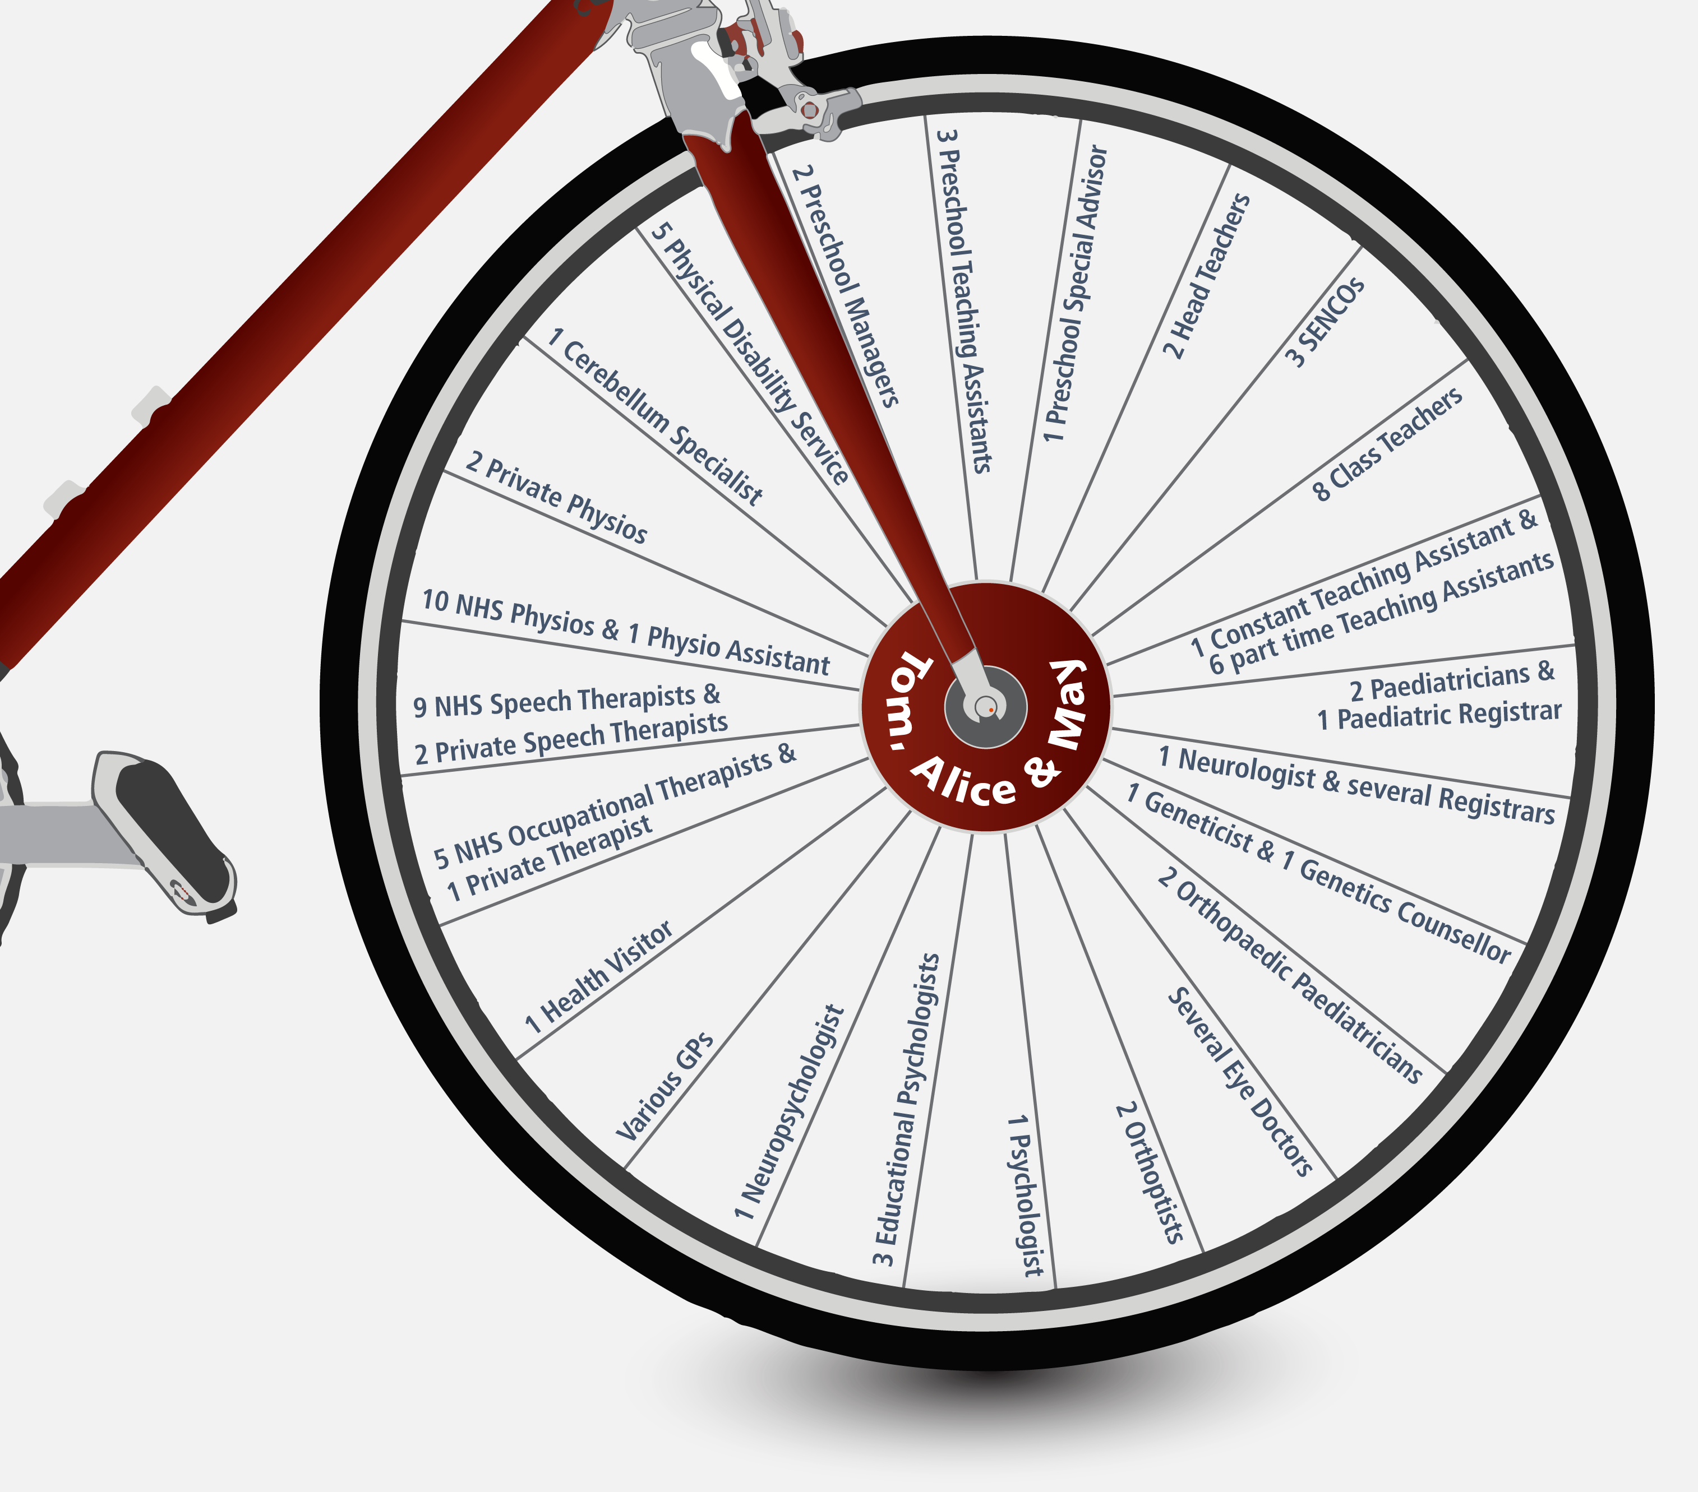
Case Study: A Parent’s View on Managing Relationships with External Professionals
When May was younger I very strongly felt the pressure of balancing all the relationships with professionals, processing and putting into action the therapeutic interventions recommended by many of them, and dealing with changes in relationship when they moved on (sometimes very suddenly). Relationships had to be formed and worked on. May tended to be less affected by those dynamics and changes than myself and my husband – we held the pressure. There were times when the image of us three at the centre of a wheel would come to me, with loads of spokes coming off representing all the different professionals. I no longer feel the weight of the wheel so intensely because the balance and dynamics of things has been completely different since May now attends a school where there is a focus on continuity and equitable partnership working. How the school works with professionals alongside parents makes a significant difference to May’s educational experiences.
This image depicts the number of professionals a family had to work with over a number of years. It is also important to note that families will be working to put in practice interventions and recommendations from the full range of professionals.
Notes:
Mentor notes:
Reflect with the trainee(s) on the case study above. What are the implications for our practice? What are the implications for the way that we work with families and with external agencies/specialist teachers?

Slide 29
Final Reflections
Working with families, with teams within our schools and with other professionals should be an equitable process of co-learning, What is the expertise that you bring to the discussion as the classroom teacher?
Families might bring certain feelings to discussions regarding their child(ren), which strategies and approaches can you use to develop a meaningful partnership with parents?
Co-learning is an important process. Where are the opportunities for this within your school system and how can you maximise these opportunities to support you to better understand how to meet the needs of your most complex learners?

Slide 30
Links to Handbook
Section 1: Understanding your role
Your role as the teacher
Wider professional responsibilities
The language we use with colleagues
Section 2: Knowledge of the learner
Pupil voice
The language we use with families
Working with families
Section 3: Planning inclusive lessons
Quality inclusive pedagogy
The language we use with learners
Working with teaching assistants
Section 6: Graduated approach
A teacher’s role in identification
Working with the SENCO
Working with external agencies and specialist teachers
Section 7: Strategies to scaffold learning
See primary area of need guidance
Section 8: Teacher wellbeing

Slide 31
Signposting
NASBTT SEND toolkit – Role of the SENCO and Classroom teachers
www.nasbtt.org.uk/new-send-toolkit/
Ask Listen Do: A guide to making conversations count for all families
https://www.sendgateway.org.uk/resources/ask-listen-do-guide-making-conversations-count-all-families
Education Endowment Foundation, Working with Parents to Support Children’s Learning: Guidance Report
https://educationendowmentfoundation.org.uk/tools/guidance-reports/working-with-parents-to-support-childrens-learning/

